Slide 1
An Introduction to Machine Learning
Notes:
https://medium.com/machine-learning-for-humans/supervised-learning-3-b1551b9c4930

Slide 2
Machine learning
Machine learning is a field of computer science that gives computers the ability to learn without being explicitly programmed.

Slide 3
Machine Learning
Machine Learning models consists algorithms that can learn and make predictions from data. Machine Learning has been evolved from prediction making and computational learning theory in artificial intelligence. It helps computers to learn and perform a certain task based on past experience. These models can be based on following:
Classification of predictions
Classification of process where machine can recognize and categorize things from datasets.

Slide 4
Categories of Machine Leaning
Machine Learning can be categorized as follows:
Supervised Learning
Teaching or training machine where data is well-labeled with correct answer or outcome
Unsupervised Learning
Machine is trained where data is not labeled
Reinforcement Leaning
Same as unsupervised learning where data is not labeled but the outcome is decided

Slide 5
Machine learning is a subfield of artificial intelligence (AI). The goal of machine learning generally is to understand the structure of data and fit that data into models that can be understood and utilized by people.
Machine learning algorithms instead allow for computers to train on data inputs and use statistical analysis in order to output values that fall within a specific range.

Slide 6
Because of this, machine learning facilitates computers in building models from sample data in order to automate decision-making processes based on data inputs.

Slide 7
Machine Learning Methods
In machine learning, tasks are generally classified into broad categories. These categories are based on how learning is received or how feedback on the learning is given to the system developed.
Two of the most widely adopted machine learning methods are supervised learning which trains algorithms based on example input and output data that is labeled by humans, and unsupervised learning which provides the algorithm with no labeled data in order to allow it to find structure within its input data.

Slide 8
Two of the most widely adopted machine learning methods are supervised learning which trains algorithms based on example input and output data that is labeled by humans, and unsupervised learning which provides the algorithm with no labeled data in order to allow it to find structure within its input data.

Slide 9
Supervised Learning
In supervised learning, the computer is provided with example inputs that are labeled with their desired outputs. The purpose of this method is for the algorithm to be able to “learn” by comparing its actual output with the “taught” outputs to find errors, and modify the model accordingly. Supervised learning therefore uses patterns to predict label values on additional unlabeled data.

Slide 10
Unsupervised Learning
In unsupervised learning, data is unlabeled, so the learning algorithm is left to find commonalities among its input data. As unlabeled data are more abundant than labeled data, machine learning methods that facilitate unsupervised learning are particularly valuable.

Slide 11
The goal of unsupervised learning may be as straightforward as discovering hidden patterns within a dataset, but it may also have a goal of feature learning, which allows the computational machine to automatically discover the representations that are needed to classify raw data.

Slide 12
Ml classification cont.
Semisupervised learning
uses both labeled and unlabeled data for training – typically a small amount of labeled data with a large amount of unlabeled data (because unlabeled data is less expensive and takes less effort to acquire)
Reinforcement learning
used for robotics, gaming and navigation. With reinforcement learning, the algorithm discovers through trial and error which actions yield the greatest rewards

Slide 13
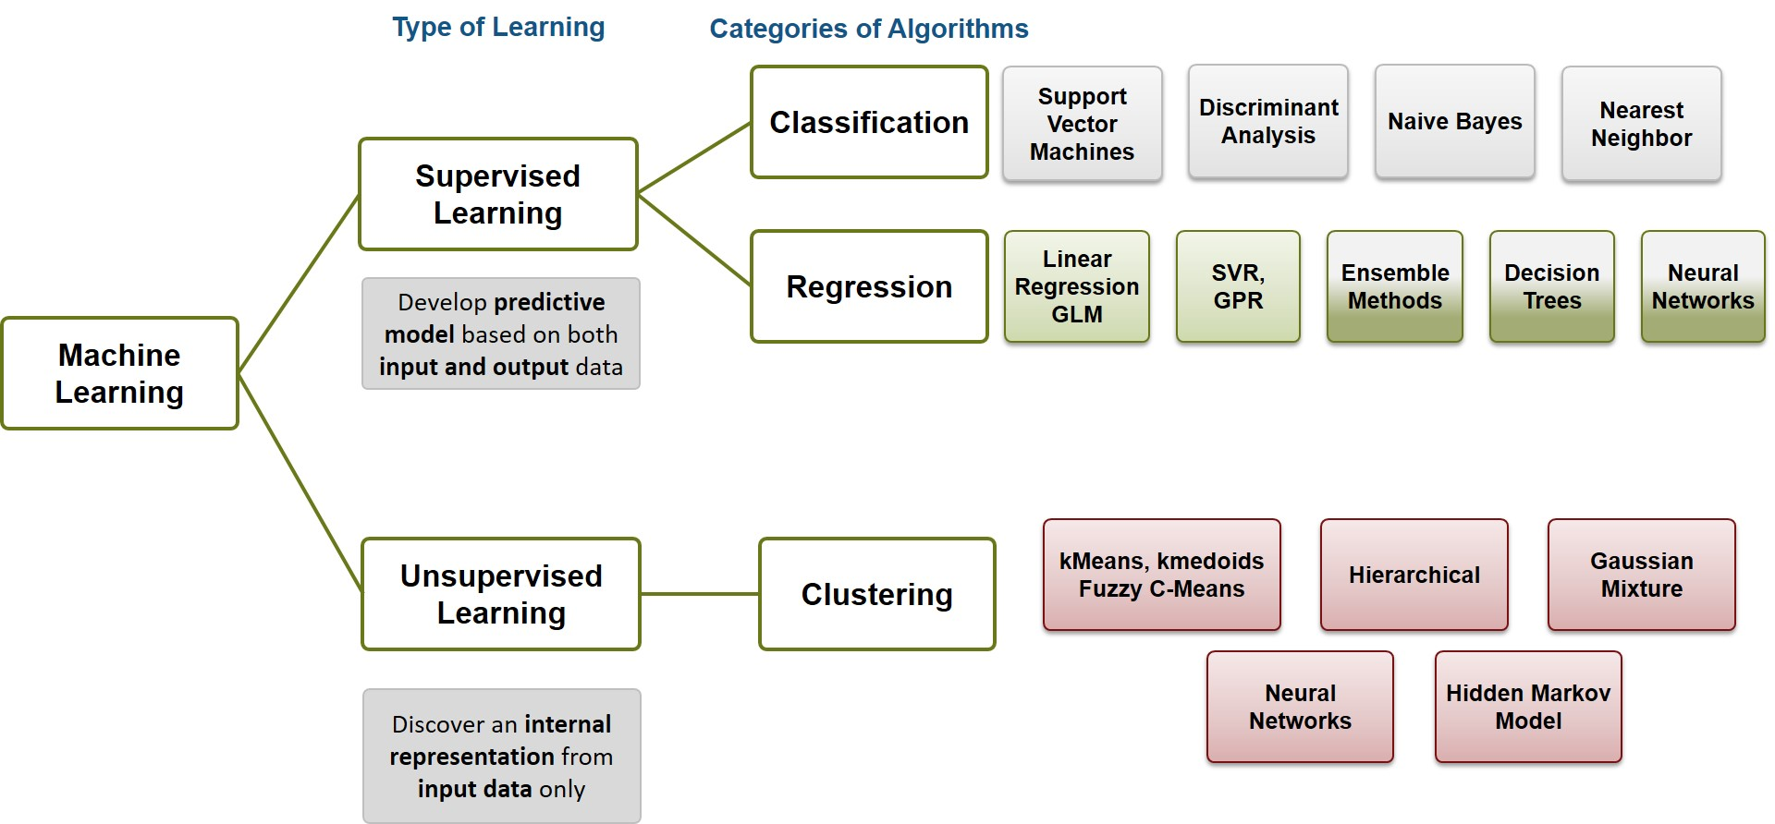
ML classification

Slide 14
Approaches
k-nearest neighbor
The k-nearest neighbor algorithm is a pattern recognition model that can be used for classification as well as regression. Often abbreviated as k-NN, the k in k-nearest neighbor is a positive integer, which is typically small. In either classification or regression, the input will consist of the k closest training examples within a space.

Slide 15
We will focus on k-NN classification. In this method, the output is class membership. This will assign a new object to the class most common among its k nearest neighbors. In the case of k = 1, the object is assigned to the class of the single nearest neighbor.

Slide 16
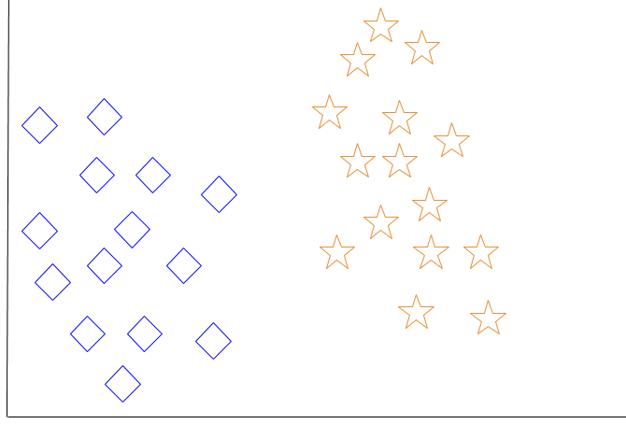

Slide 17
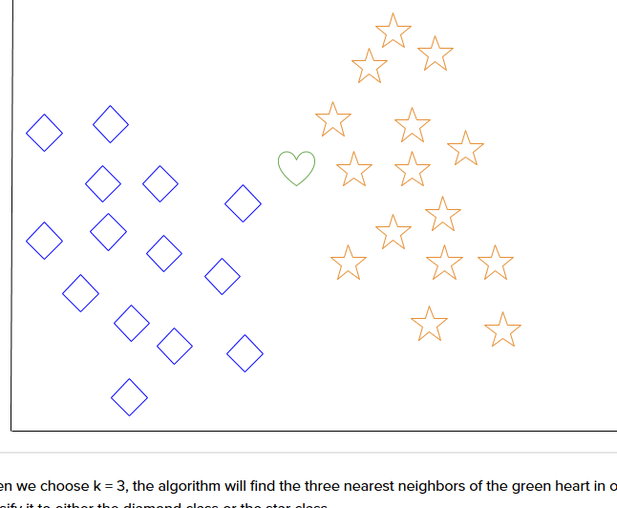
Notes:
When a new object is added to the space — in this case a green heart — we will want the machine learning algorithm to classify the heart to a certain class.

Slide 18
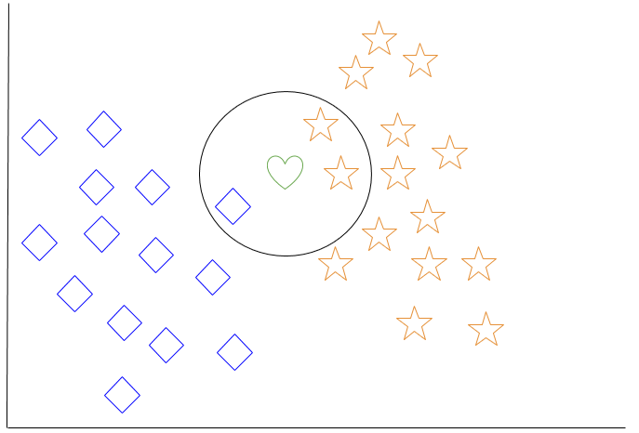
Notes:
Among the most basic of machine learning algorithms, k-nearest neighbor is considered to be a type of “lazy learning” as generalization beyond the training data does not occur until a query is made to the system.

Slide 19
Decision Tree Learning
decision trees are employed to visually represent decisions and show or inform decision making. When working with machine learning and data mining, decision trees are used as a predictive model. These models map observations about data to conclusions about the data’s target value.

Slide 20
The goal of decision tree learning is to create a model that will predict the value of a target based on input variables.
In the predictive model, the data’s attributes that are determined through observation are represented by the branches, while the conclusions about the data’s target value are represented in the leaves.

Slide 21
When “learning” a tree, the source data is divided into subsets based on an attribute value test, which is repeated on each of the derived subsets recursively. Once the subset at a node has the equivalent value as its target value has, the recursion process will be complete.

Slide 22
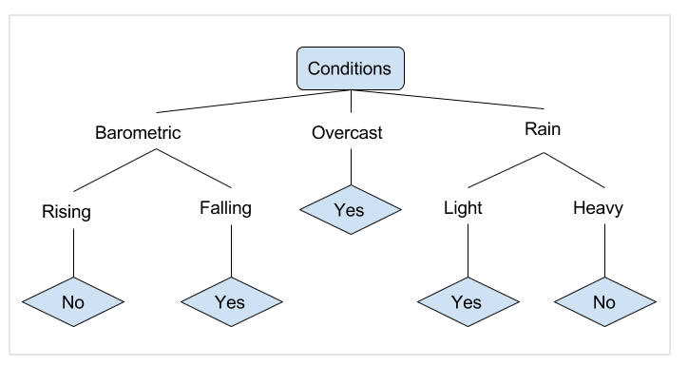
Notes:
In the simplified decision tree above, an example is classified by sorting it through the tree to the appropriate leaf node. This then returns the classification associated with the particular leaf, which in this case is either a Yes or a No. The tree classifies a day’s conditions based on whether or not it is suitable for going fishing.
A true classification tree data set would have a lot more features than what is outlined above, but relationships should be straightforward to determine. When working with decision tree learning, several determinations need to be made, including what features to choose, what conditions to use for splitting, and understanding when the decision tree has reached a clear ending.

Slide 23
Deep Learning
Deep learning attempts to imitate how the human brain can process light and sound stimuli into vision and hearing. A deep learning architecture is inspired by biological neural networks and consists of multiple layers in an artificial neural network made up of hardware and GPUs.

Slide 24
Deep Learning
Deep learning uses a cascade of nonlinear processing unit layers in order to extract or transform features (or representations) of the data. The output of one layer serves as the input of the successive layer. In deep learning, algorithms can be either supervised and serve to classify data, or unsupervised and perform pattern analysis.

Slide 25
Deep Learning
Among the machine learning algorithms that are currently being used and developed, deep learning absorbs the most data and has been able to beat humans in some cognitive tasks. Because of these attributes, deep learning has become the approach with significant potential in the artificial intelligence space

Slide 26
Supervised Learning
The two tasks of supervised learning: regression and classification. Linear regression, loss functions, and gradient descent.

Slide 27
Supervised Learning
How much money will we make by spending more dollars on digital advertising?
Will this loan applicant pay back the loan or not?
What’s going to happen to the stock market tomorrow?

Slide 28
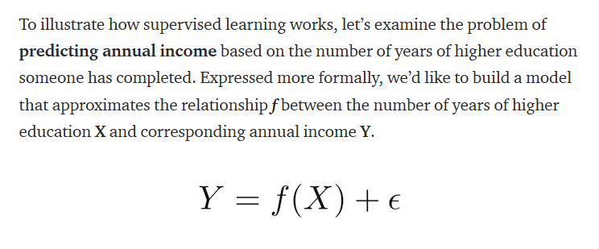
Supervised Learning

Slide 29
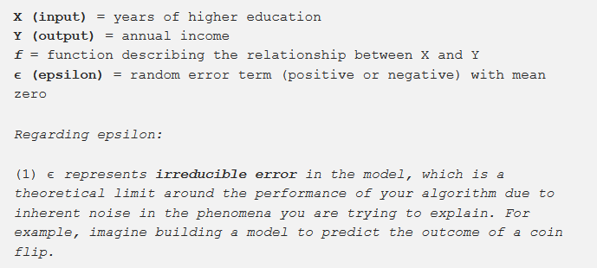

Slide 30
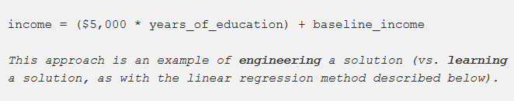

Slide 31
In supervised learning, the machine attempts to learn the relationship between income and education from scratch, by running labeled training data through a learning algorithm. This learned function can be used to estimate the income of people whose income Y is unknown, as long as we have years of education X as inputs. In other words, we can apply our model to the unlabeled test data to estimate Y.

Slide 32
The two tasks of supervised learning: regression and classification
Regression: predict a continuous numerical value. How much will that house sell for?
Classification: assign a label. Is this a picture of a cat or a dog?

Slide 33
Regression: predicting a continuous value
Regression predicts a continuous target variable Y. It allows you to estimate a value, such as housing prices or human lifespan, based on input data X.
Notes:
Predicting income is a classic regression problem. Your input data X includes all relevant information about individuals in the data set that can be used to predict income, such as years of education, years of work experience, job title, or zip code. These attributes are called features, which can be numerical (e.g. years of work experience) or categorical (e.g. job title or field of study).

Slide 34
The data is split into a training data set and a test data set. The training set has labels, so your model can learn from these labeled examples. The test set does not have labels, i.e. you don’t yet know the value you’re trying to predict. It’s important that your model can generalize to situations it hasn’t encountered before so that it can perform well on the test data.

Slide 35
Overfitting
A common problem in machine learning is overfitting: learning a function that perfectly explains the training data that the model learned from, but doesn’t generalize well to unseen test data.
Overfitting happens when a model overlearns from the training data to the point that it starts picking up idiosyncrasies that aren’t representative of patterns in the real world.

Slide 36
This becomes especially problematic as you make your model increasingly complex. Underfitting is a related issue where your model is not complex enough to capture the underlying trend in the data.

Slide 37
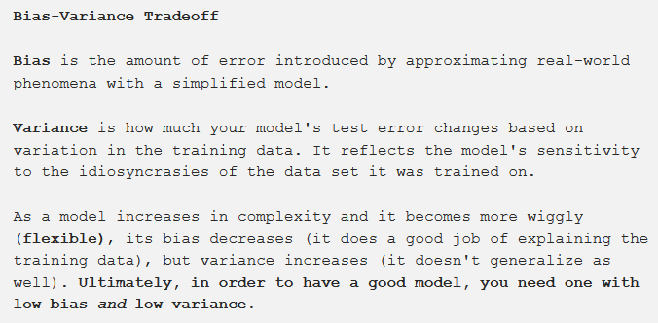

Slide 38
Supervised Learning
Classification with logistic regression and support vector machines (SVMs).
Is this email spam or not?
Is that borrower going to repay their loan?
Will those users click on the ad or not?
Who is that person in your Facebook picture?

Slide 39
Classification predicts a discrete target label Y. Classification is the problem of assigning new observations to the class to which they most likely belong, based on a classification model built from labeled training data.
The accuracy of your classifications will depend on the effectiveness of the algorithm you choose, how you apply it, and how much useful training data you have.

Slide 40
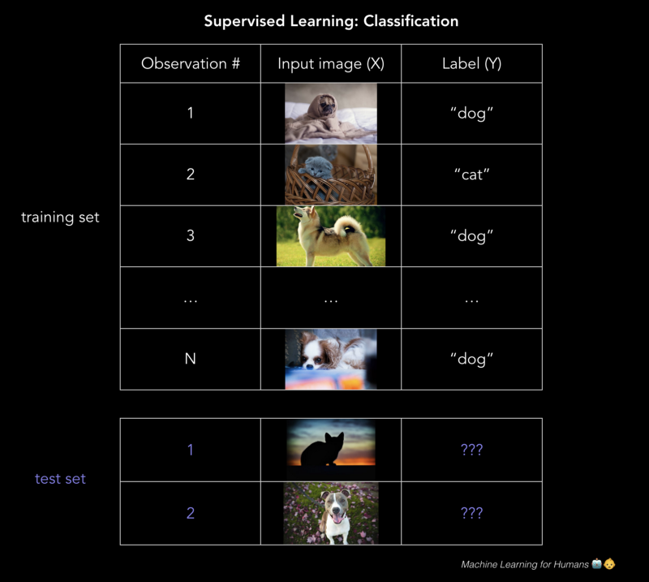

Slide 41
Logistic regression: 0 or 1?
Logistic regression is a method of classification: the model outputs the probability of a categorical target variable Y belonging to a certain class.
Notes:
A good example of classification is determining whether a loan application is fraudulent.Ultimately, the lender wants to know whether they should give the borrower a loan or not, and they have some tolerance for risk that the application is in fact fraudulent. In this case, the goal of logistic regression is to calculate the probability (between 0% and 100%) that the application is fraud. With these probabilities, we can set some threshold above which we’re willing to lend to the borrower, and below which we deny their loan application or flag the application for further review.

Slide 42
Though logistic regression is often used for binary classification where there are two classes, keep in mind that classification can performed with any number of categories (e.g. when assigning handwritten digits a label between 0 and 9, or using facial recognition to detect which friends are in a Facebook picture).

Slide 43
Can I just use ordinary least squares?
Nope. If you trained a linear regression model on a bunch of examples where Y = 0 or 1, you might end up predicting some probabilities that are less than 0 or greater than 1, which doesn’t make sense. Instead, we’ll use a logistic regression model (or logit model) which was designed for assigning a probability between 0% and 100% that Y belongs to a certain class.

Slide 44
Support vector machines (SVMs)
“We’re in a room full of marbles again. Why are we always in a room full of marbles? I could’ve sworn we already lost them.”

Slide 45
Support vector machines (SVMs)
SVM is the last parametric model we’ll cover. It typically solves the same problem as logistic regression — classification with two classes — and yields similar performance. It’s worth understanding because the algorithm is geometrically motivated in nature, rather than being driven by probabilistic thinking.

Slide 46
Support vector machines (SVMs)
A few examples of the problems SVMs can solve:
Is this an image of a cat or a dog?
Is this review positive or negative?
Are the dots in the 2D plane red or blue?

Slide 47
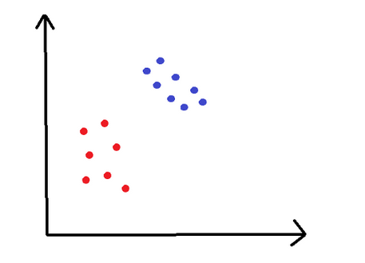
Notes:
In this example, we have points in a 2D space that are either red or blue, and we’d like to cleanly separate the two.
The training set is plotted the graph above. We would like to classify new, unclassified points in this plane. To do this, SVMs use a separating line (or, in more than two dimensions, a multi-dimensional hyperplane) to split the space into a red zone and a blue zone. You can already imagine how a separating line might look in the graph above.

Slide 48
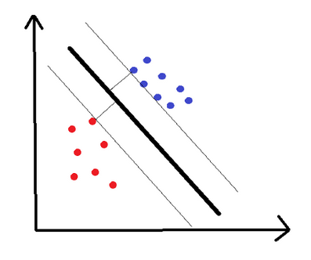
How, specifically, do we choose where to draw the line? Below are two examples of such a line:

Slide 49
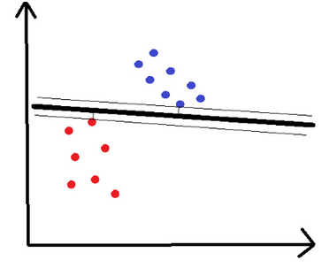

Slide 50
Support vector machines (SVMs)
Hopefully, you share the intuition that the first line is superior. The distance to the nearest point on either side of the line is called the margin, and SVM tries to maximize the margin. You can think about it like a safety space: the bigger that space, the less likely that noisy points get misclassified.

Slide 51
1. How does the math behind this work?
We want to find the optimal hyperplane (a line, in our 2D example). This hyperplane needs to (1) separate the data cleanly, with blue points on one side of the line and red points on the other side, and (2) maximize the margin. This is an optimization problem. The solution has to respect constraint (1) while maximizing the margin as is required in (2).

Slide 52
2. What happens if you can’t separate the data cleanly?
There are two methods for dealing with this problem.
2.1. Soften the definition of “separate”.
We allow a few mistakes, meaning we allow some blue points in the red zone or some red points in the blue zone. We do that by adding a cost C for misclassified examples in our loss function. Basically, we say it’s acceptable but costly to misclassify a point.

Slide 53
2.2. Throw the data into higher dimensions.
We can create nonlinear classifiers by increasing the number of dimensions, i.e. include x², x³, even cos(x), etc. Suddenly, you have boundaries that can look more squiggly when we bring them back to the lower dimensional representation.

Slide 54
Intuitively, this is like having red and blue marbles lying on the ground such that they can’t be cleanly separated by a line — but if you could make all the red marbles levitate off the ground in just the right way, you could draw a plane separating them. Then you let them fall back to the ground knowing where the blues stop and reds begin.

Slide 55
Supervised Learning
Non-parametric models: k-nearest neighbors, decision trees, and random forests. Introducing cross-validation, hyperparameter tuning, and ensemble models.

Slide 56
Non-parametric learners.
In contrast to the methods we’ve covered so far — linear regression, logistic regression, and SVMs where the form of the model was pre-defined — non-parametric learners do not have a model structure specified a priori. We don’t speculate about the form of the function f that we’re trying to learn before training the model, as we did previously with linear regression. Instead, the model structure is purely determined from the data.

Slide 57
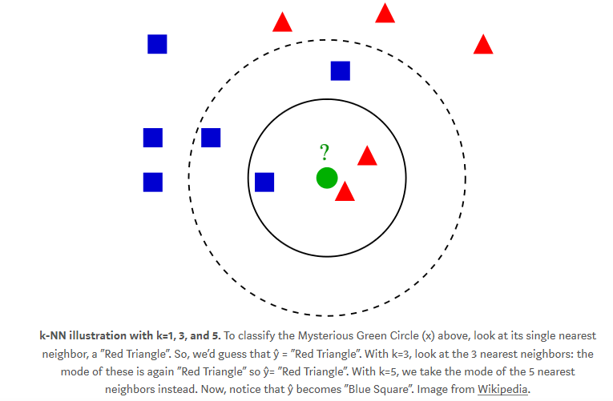
k-nearest neighbors (k-NN)

Slide 58
That’s it. That’s k-nearest neighbors. You look at the k closest data points and take the average of their values if variables are continuous (like housing prices), or the mode if they’re categorical (like cat vs. dog).
If you wanted to guess unknown house prices, you could just take the average of some number of geographically nearby houses, and you’d end up with some pretty nice guesses. These might even outperform a parametric regression model built by some economist that estimates model coefficients for # of beds/baths, nearby schools, distance to public transport, etc.

Slide 59
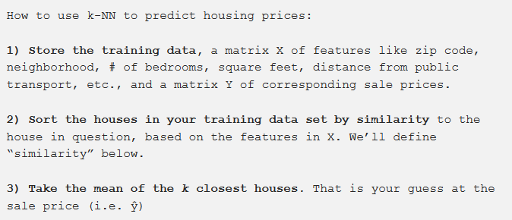

Slide 60
The fact that k-NN doesn’t require a pre-defined parametric function f(X) relating Y to X makes it well-suited for situations where the relationship is too complex to be expressed with a simple linear model.

Slide 61

Remember the Pythagorean theorem for finding the length of the hypotenuse of a right triangle?
c = length of hypotenuse (green line above). a and b = length of the other sides, at a right angle (red lines above).

Slide 62
Where to use k-NN in the real world
Some examples of where you can use k-NN:
Classification: fraud detection. The model can update virtually instantly with new training examples since you’re just storing more data points, which allows quick adaptation to new methods of fraud.
Regression: predicting housing prices. In housing price prediction, literally being a “near neighbor” is actually a good indicator of being similar in price. k-NN is useful in domains where physical proximity matters.
Imputing missing training data. If one of the columns in your .csv has lots of missing values, you can impute the data by taking the mean or mode. k-NN could give you a somewhat more accurate guess at each missing value.

Slide 63
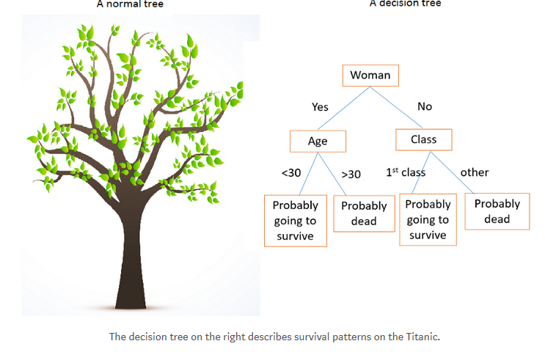
Decision trees, random forests
Notes:
The first split separates our dataset into men and women. Then, the women branch gets split again in age (the split that minimizes entropy). Similarly, the men branch gets split by class. By following the tree for a new passenger, you can use the tree to make a guess at whether they died.
The Titanic example is solving a classification problem (“survive” or “die”). If we were using decision trees for regression — say, to predict housing prices — we would create splits on the most important features that determine housing prices. How many square feet: more than or less than ___? How many bedrooms & bathrooms: more than or less than ___?
Then, during testing, you would run a specific house through all the splits and take the average of all the housing prices in the final leaf node (bottom-most node) where the house ends up as your prediction for the sale price.

Slide 64
There are a few hyperparameters you can tune with decision trees models, including max_depth and max_leaf_nodes.
Decision trees are effective because they are easy to read, powerful even with messy data, and computationally cheap to deploy once after training. Decision trees are also good for handling mixed data (numerical or categorical).

Slide 65
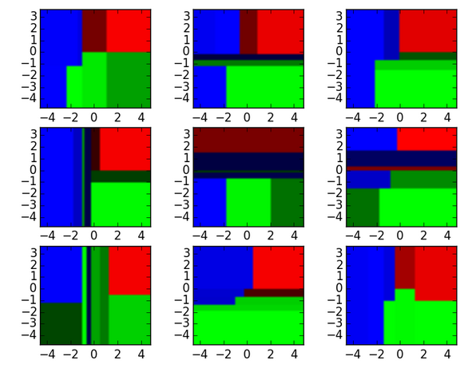
To illustrate, see these nine decision tree classifiers below.

Slide 66
These decision tree classifiers can be aggregated into a random forest ensemble which combines their input. Think of the horizontal and vertical axes of each decision tree output as features x1 and x2. At certain values of each feature, the decision tree outputs a classification of “blue”, “green”, “red”, etc.

Slide 67
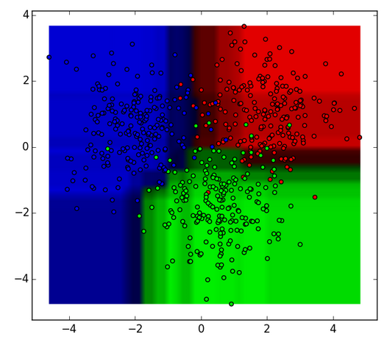

Slide 68
These results are aggregated, through modal votes or averaging, into a single ensemble model that ends up outperforming any individual decision tree’s output.
Random forests are an excellent starting point for the modeling process, since they tend to have strong performance with a high tolerance for less-cleaned data and can be useful for figuring out which features actually matter among many features.

